Slide 1
KTB PLOAN
SCORING PROGRAM
DOCUMENTATION
(CONTROL PROGRAM)
Covers Version 1.42
September 11, 2006
Decision Analytics Consulting

Slide 2
CONTENTS
Technical highlights
Input and output environment
Program flow
Program files

Slide 3
TECHNICAL HIGHLIGHTS
Windows-based program
Developed with Borland C++ Builder 6
Require Microsoft SQL server 2000 database to operate
Require the following eight Borland run-time library to operate:
  adortl60.bpl − borlandmm.dll − cc3260mt.dll
  dbrtl60.bpl − rtl60.bpl − stlpmt45.dll
  vcl60.bpl − vclx60.bpl
Require GSS e-JCIC client COM+ component
Connect to database via Microsoft ADO (Active Data Objects)

Slide 4
CONTENTS
Technical highlights
Input and output environment
Program flow
Program files

Slide 5
INPUT ENVIRONMENT
 | Data items / table
Graphical user interface | Personal Name • IDN Birthday • Marital status Number of children • Education Phone numbers • Annual income 3-digit residence zip code Product APR • Application amount Application loan terms
SQL server 2000 database tables | RESULT^{(*)}
(*) For report generation

Slide 6
DETAILED RESULT TABLE DEFINITION
Column name | Data type | Description | NULL permitted
IDN | Char(11) | 身分證號 | Yes
INPUT_TIME | Char(12) | 資料輸入時間 (YYYYMMDDHHMi (accurate to the minute)) | Yes
PB | Decimal(6,5) | 壞帳機率 (5%為0.05) | Yes
NPV | Int | NPV(新台幣元) | Yes
SUGGESTION | Char(60) | 核准模組輸出訊息 | Yes
SUGGESTION_CODE | int | 核准模組輸出訊息代碼 | Yes
RESULT_FILE_GEN_ TIME | Char(12) | 審核報表產生時間 (YYYYMMDDHHMi (accurate to the minute)) | Yes
MIN_RATE | Decimal(5,4) | 最低可貸利率(5%為0.05) | Yes
APPROVED_AMOUNT | Int | 模組核准金額(新台幣元) | Yes

Slide 7
DETAILED RESULT TABLE DEFINITION(CONT.)
Column name | Data type | Description | NULL permitted
UNSECURED_BALANCE | Int | 無擔保餘額(新台幣元) | Yes
APPROVED_AMOUNT_FSC | Int | 金管會規定下最高可貸金額(新台幣元) | Yes
SEPCIAL_NOTE | Char(2048) | VAM102補充註記 | Yes
UNSECURED_BALANCE_DAC | Int | DAC定義之無擔保餘額(新台幣元) | Yes
VERSION | Varchar(10) | 核准模組版本編號 | Yes
MODULE_CODE | Int | 核准模組輸出代碼 (for analytics) | Yes

Slide 8
OUTPUT ENVIRONMENT
 | Messages | Results
Graphical user interface | Input error message Program execution messages Module error messages | None
SQL server 2000 database tables | None | APPLICANT JCIC tables

Slide 9
DETAILED APPLICANT TABLE DEFINITION
Column name | Data type | Description | NULL permitted
INPUT_TIME | Char(12) | YYYYMMDDHHMi (accurate to the minute) | Yes
IDN | Char(11) | 身分證號 | Yes
CNAME | Char(20) | 姓名 | Yes
BIRTHDAY | Char(8) | 生日 | Yes
ZIP | Char(3) | 居住地三碼郵遞區號 | Yes
FIXED_LINE_PHONE | Char(10) | 市話號碼 | Yes
CELL_PHONE | Char(10) | 行動電話號碼 | Yes
APPLICATION_AMOUNT | Int | 申貸金額(新台幣元) | Yes
APPLICATION_RATE | Decimal(6, 5) | 申貸利率 (5% 為 0.05) | Yes
APPLICATION_TERMS | Int | 申貸期數(期) | Yes
APPLICATION_FEE | Int | 申請費(新台幣元) | Yes
MONTHLY_INCOME | Int | 月收入(新台幣元) | Yes

Slide 10
DETAILED APPLICANT TABLE DEFINITION(CONT.)
Column name | Data type | Description | NULL permitted
CHANNEL | Char(20) | 進件員工 | Yes
MARRIAGE | Int | 婚姻狀況(1：未婚；2：已婚；3：離婚；4：其他) | Yes
CHILDREN | Int | 子女數代碼(1：無；2：一個；3：兩個；4：個以上；5 ：其他) | Yes
EDUCATION | Int | 教育程度代碼(1：國中；2：高中；3：大專；4：碩士；5：博士；6：其他) | Yes
INPUT_USER | Varchar(40) | 資料輸入使用者帳號 | Yes
PRODUCT_TYPE | Int | 產品代碼(1：農家樂；2：便利通；3：薪優待) | Yes
BRANCH | Char(4) | 進件分行編號 | Yes

Slide 11
DETAILED JCIC TABLES DEFINITIONS
KRM023
Column name | Data type | Description | NULL permitted
INPUT_TIME | Char(12) | 資料輸入時間 (YYYYMMDDHHMi (accurate to the minute)) | No
IDN | Char(11) | 身分證號 | No
INQUIRY_DATE | Char(8) | 聯徵查詢日期(YYYYMMDD) | No
YRMON | Char(5) | 資料年月(YYYMM, YYY為民國年) | Yes
ISSUE | Char(3) | 發卡機構代號 | No
ISSUE_NAME | Char(40) | 發卡機構名稱 | Yes
KR_CODE | Char(7) | 信用卡別 | Yes
LIMIT | Char(5) | 核定額度(新台幣千元) | Yes
PAYMENT | Char(3) | 應繳金額級距(元)(位數+HML) | Yes
CASH | Char(1) | 預借現金有無(Y/N) | Yes
PAY_CODE | Char(1) | 繳款狀況代號 | Yes

Slide 12
DETAILED JCIC TABLES DEFINITIONS
KRM021
Column name | Data type | Description | NULL permitted
INPUT_TIME | Char(12) | 資料輸入時間 (YYYYMMDDHHMi(accurate to the minute)) | No
IDN | Char(11) | 身分證號 | No
INQUIRY_DATE | Char(8) | 聯徵查詢日期(YYYYMMDD) | No
CARD_BRAND | Char(1) | 卡名代號 | Yes
CARD_TYPE | Char(1) | 標章代號 | Yes
ISSUE | Char(3) | 發卡機構代號 | Yes
ISSUE_NAME | Char(40) | 發卡機構名稱 | Yes
START_DATE | Char(7) | 啟用日期(YYYMMDD, YYY為民國年) | Yes
STOP_DATE | Char(7) | 停用日期(YYYMMDD, YYY為民國年) | Yes
STOP_CODE | Char(1) | 停用種類代號 | Yes

Slide 13
DETAILED JCIC TABLES DEFINITIONS
KRM021(CONT.)
Column name | Data type | Description | NULL permitted
AB_CODE | Char(1) | 停用原因代號 | Yes
M_S | Char(1) | 主附卡 (YN) | Yes
RELA | Char(1) | 〔僅附卡〕主附卡關係代號 | Yes
LIMIT | Char(6) | 額度（新台幣千元） | Yes
RISK | Char(6) | 〔僅停用原因＝P〕風險損失金額（千元） | Yes
CLEAR_DATE | Char(7) | 〔僅停用原因＝U〕欠款結清日期 | Yes
IDN_PRI | Char(10) | 〔僅附卡〕主卡人身分證號 | Yes
CNAME | Char(12) | 〔僅附卡〕主卡人姓名 | Yes
REMARK | Char(40) | 註記 | Yes

Slide 14
DETAILED JCIC TABLES DEFINITIONS
BAM086
Column name | Data type | Description | NULL permitted
INPUT_TIME | Char(12) | 資料輸入時間 (YYYYMMDDHHMi (accurate to the minute)) | No
IDN | Char(11) | 身分證號 | No
INQUIRY_DATE | Char(8) | 聯徵查詢日期(YYYYMMDD) | No
DATA_YYY | Char(3) | 資料年度(民國年) | Yes
DATA_MM | Char(2) | 資料月份 | Yes
BANK_CODE | Char(7) | 行庫代號 | Yes
BANK_NAME | Char(40) | 行庫名稱 | Yes

Slide 15
DETAILED JCIC TABLES DEFINITIONS
BAM086(CONT.)
Column name | Data type | Description | NULL permitted
ACCOUNT_CODE | Char(1) | 會計科目 | Yes
ACCOUNT_CODE2 | Char(1) | 會計科目註記 | Yes
PURPOSE_CODE | Char(1) | 用途別 | Yes
CONTRACT_AMT | Int | 訂約金額 (新台幣千元) | Yes
LOAN_AMT | Int | 放款未逾期 (新台幣千元) | Yes
PASS_DUE_AMT | Int | 逾期未還金額 (新台幣千元) | Yes
PAY_CODE_12 | Char(12) | 最近12個月還款紀錄 | Yes
CO_LOAN | Char(1) | 共同借款註記 | Yes

Slide 16
DETAILED JCIC TABLES DEFINITIONS
JAS002
Column name | Data type | Description | NULL permitted
INPUT_TIME | Char(12) | 資料輸入時間 (YYYYMMDDHHMi (accurate to the minute)) | No
IDN | Char(11) | 身分證號 | No
INQUIRY_DATE | Char(8) | 聯徵查詢日期(YYYYMMDD) | No
EVER_DELINQUENT | Char(1) | 授信異常 (Y/N) | Yes
DELINQUENT_DATE | Char(7) | 最近授信異常日期 | Yes
EVER_BAD_CHECK | Char(1) | 退票異常 (Y/N) | Yes
BAD_CHECK_DATE | Char(7) | 最近退票異常日期 | Yes
EVER_REJECT | Char(1) | 拒絕往來紀錄 (Y/N) | Yes
REJECT_DATE | Char(7) | 拒絕往來日期 | Yes
EVER_STOP_CARD | Char(1) | 強制停卡異常 (Y/N) | Yes
STOP_CARD_DATE | Char(7) | 最近強制停卡日期 | Yes

Slide 17
DETAILED JCIC TABLES DEFINITIONS
STM007
Column name | Data type | Description | NULL permitted
IINPUT_TIME | Char(12) | 資料輸入時間 (YYYYMMDDHHMi (accurate to the minute)) | No
IDN | Char(11) | 身分證號 | No
INQUIRY_DATE | Char(8) | 聯徵查詢日期(YYYYMMDD) | No
QUERY_DATE | Char(7) | 查詢日期(YYYMMDD, YYY為民國年) | Yes
BANK_CODE | Char(7) | 查詢單位代號 | Yes
BANK_NAME | Char(40) | 查詢單位名稱 | Yes
ITEM_LIST | Char(10) | 查詢項目串列 B:授信 D:票信 K:信用卡等 | Yes
INQ_PURPOSE_1 | Char(1) | 查詢理由碼 | Yes
INQ_PURPOSE | Char(30) | 查詢理由碼(中文註解) 1:新業務申請2:原業務往來 3 :新業務申請及原業務往來 | Yes

Slide 18
DETAILED JCIC TABLES DEFINITIONS
KRM037
Column name | Data type | Description | NULL permitted
INPUT_TIME | Char(12) | 資料輸入時間 (YYYYMMDDHHMi (accurate to the minute)) | No
IDN | Char(11) | 身分證號 | No
INQUIRY_DATE | Char(8) | 聯徵查詢日期(YYYYMMDD) | No
BILL_DATE | Char(7) | 結帳日(YYYMMDD, YYY為民國年) | Yes
ISSUE | Char(3) | 發卡機構代號 | Yes
ISSUE_NAME | Char(24) | 行庫代號 | Yes
CARD_TYPE | Char(7) | 信用卡別 | Yes
PERM_LIMIT | Int | 永久額度(新台幣千元) | Yes
TEMP_LIMIT | Int | 臨時額度(新台幣千元) | Yes
CASH_LIMIT | Int | 預借現金額度(新台幣千元) | Yes
PAYABLE | Char(3) | 本期應付帳款 | Yes
CASH_LENT | Int | 本期預借現金(新台幣元) | Yes

Slide 19
DETAILED JCIC TABLES DEFINITIONS
KRM037(CONT.)
Column name | Data type | Description | NULL permitted
LAST_PAYA | Char(3) | 上期應付帳款 | Yes
REVOL_BAL | Int | 上期循環信用(新台幣元) | Yes
PAY_STAT | Char(1) | 上期繳款狀況代號(金額) | Yes
PAY_CODE | Char(1) | 上期繳款狀況代號(時間)
REVOL_RATE | Int | 上期循環比率 REVOL_BAL/PERM_LIMIT 精確度至小數點後2位(四捨五入);非百分比 | Yes
PRE_OWED | Int | 未到期分期償還待付金額 未到期代墊消費款金額+未到期分期償還預借現金金額 ,不包括本期新增餘額代償 | Yes
DEBT_CODE | Char(1) | 債權狀況註記 | Yes
CLOSE_CODE | Char(1) | 債權結案註記 | Yes
CLEAR_DATE | Char(7) | 不良債權結案日期(YYYMMDD, YYY為民國年) | Yes

Slide 20
DETAILED JCIC TABLES DEFINITIONS
VAM102
Column name | Data type | Description | NULL permitted
INPUT_TIME | Char(12) | 資料輸入時間 (YYYYMMDDHHMi (accurate to the minute)) | No
INQUIRY_DATE | Char(8) | 聯徵查詢日期(YYYYMMDD) | No
IDN | Char(11) | 身分證號 | No
DATA_DATE | Char(7) | 訊息登錄日期 | Yes
MAINCODE | Char(1) | 訊息種類大項代碼 | Yes
MAINNOTE | Char(36) | 訊息種類大項 | Yes
SUBCODE | Char(1) | 訊息種類細項代碼 | Yes
SUBNOTE | Char(60) | 訊息種類細項 | Yes
NOTE | Char(100) | 訊息內容 | Yes

Slide 21
REFERENCE ENVIRONMENT
Seven SQL Server database tables
AGENT
  Contains user name and password to log into the scoring program
  Change is made via Microsoft SQL Server access tools
  Change whenever
    there is change in input personnel
    there is a need to change password
BRANCH
  Contains all braches of KTB
  Change is made via Microsoft SQL Server access tools
  Change whenever
    there is a new branch open
    there is an existing branch closed
    there is change to the branch coding

Slide 22
REFERENCE ENVIRONMENT(CONT.)
CFC
  Contains all consumer finance processing centers
  Change is made via Microsoft SQL Server access tools
  Change whenever
    there is a new consumer finance processing center open
    there is an existing consumer finance processing center closed
    there is a change to the consumer finance processing center coding
CFC_BRANCH
  Contains the relationship between CFCs and branches
  Change is made via Microsoft SQL Server access tools
  Change whenever
    there is a change to the relationship between CFCs and their branches
    there is a new consumer finance processing center open
    there is an existing consumer finance processing center closed
    there is a change to the consumer finance processing center coding
    there is a new branch open
    there is an existing branch closed
    there is a change to the branch coding

Slide 23
REFERENCE ENVIRONMENT(CONT.)
MARRIAGE_LOOKUP
  Contains mapping between the codes and meaning to marital status
  Change is made via Microsoft SQL Server access tools
  Change whenever
    there is a new marital status category added
    there is an existing marital status category deleted
    there is a change to the marital status coding
CHILDREN_LOOKUP
  Contains mapping between the coding and meaning to number of children
  Change is made via Microsoft SQL Server access tools
  Change whenever
    there is a change to the number of children coding
    there is an existing number of children category deleted
    there is a change to the marriage status coding

Slide 24
REFERENCE ENVIRONMENT(CONT.)
EDUCATION_LOOKUP
  Contains mapping between the codes and meaning to highest education
  Change is made via Microsoft SQL Server access tools
  Change whenever
    there is a new highest education category added
    there is an existing highest education category deleted
    there is a change to the highest education coding

Slide 25
DETAILED REFERENCE TABLES DEFINITIONS
AGENT
Column name | Data type | Description | NULL permitted
USERID | Varchar(256) | 使用者帳號 | No
USERPW | Varchar(256) | 使用者密碼 | No

Slide 26
DETAILED REFERENCE TABLES DEFINITIONS
BRANCH
Column name | Data type | Description | NULL permitted
BRANCH_CODE | Varchar(4) | 分行代號 | No
BRANCH | Varchar(60) | 分行名稱 | No

Slide 27
DETAILED REFERENCE TABLES DEFINITIONS
CFC
Column name | Data type | Description | NULL permitted
CFC_CODE | Varchar(4) | 消金中心代號 | No
CFC | Varchar(60) | 消金中心名稱 | No

Slide 28
DETAILED REFERENCE TABLES DEFINITIONS
CFC_BRANCH
Column name | Data type | Description | NULL permitted
CFC_CODE | Varchar(4) | 消金中心代號 | No
BRANCH_CODE | Varchar(4) | 分行代號 | No

Slide 29
DETAILED REFERENCE TABLES DEFINITIONS
MARRIAGE_LOOKUP
Column name | Data type | Description | NULL permitted
CODE | Int | 代碼 | No
DES | Varchar(4) | 婚姻狀況 | No

Slide 30
DETAILED REFERENCE TABLES DEFINITIONS
CHILDREN_LOOKUP
Column name | Data type | Description | NULL permitted
CODE | Int | 代碼 | No
DES | Varchar(4) | 子女數類別 | No

Slide 31
DETAILED REFERENCE TABLES DEFINITIONS
EDUCATION_LOOKUP
Column name | Data type | Description | NULL permitted
CODE | Int | 代碼 | No
DES | Varchar(4) | 最高學歷 | No

Slide 32
CONTENTS
Technical highlights
Input and output environment
Program flow
Program files

Slide 33
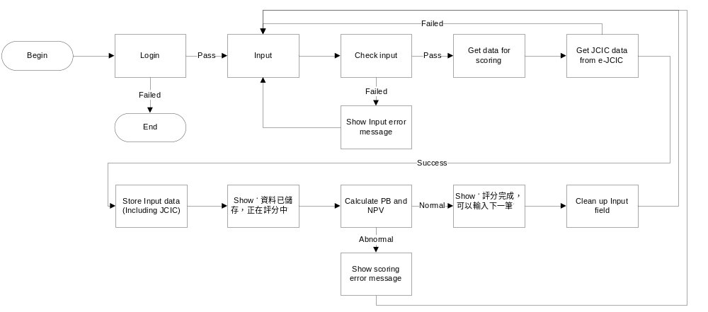
PROGRAM FLOW OVERVIEW

Slide 34
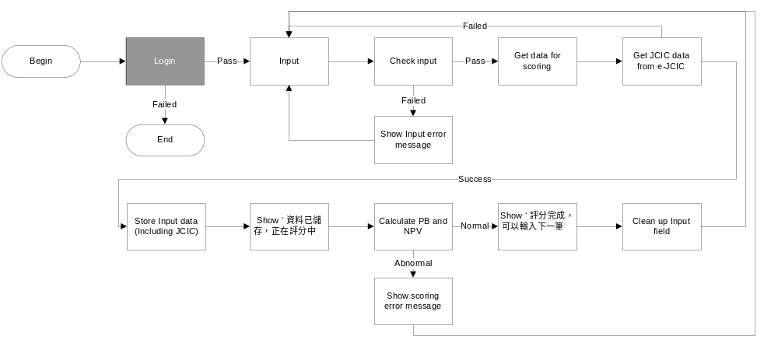
LOGIN

Slide 35
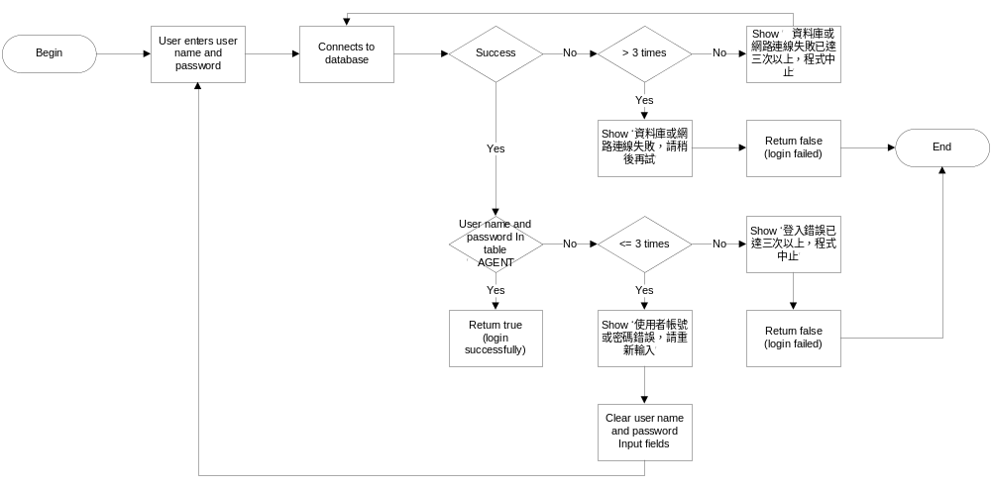
LOGIN

Slide 36
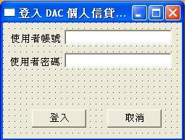
LOGIN

Slide 37
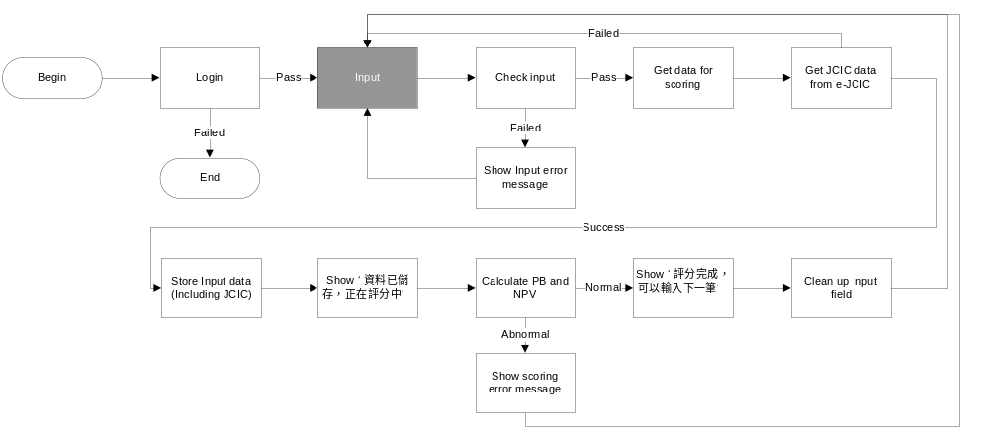
INPUT

Slide 38
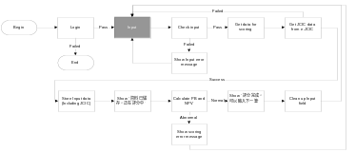
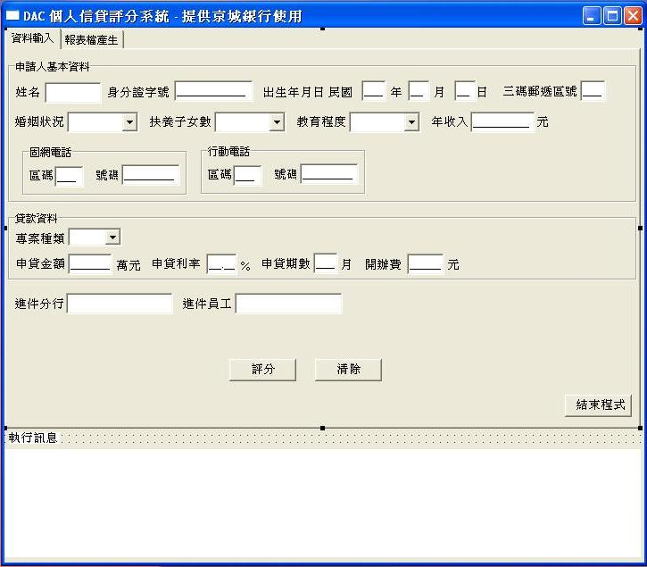
INPUT

Slide 39
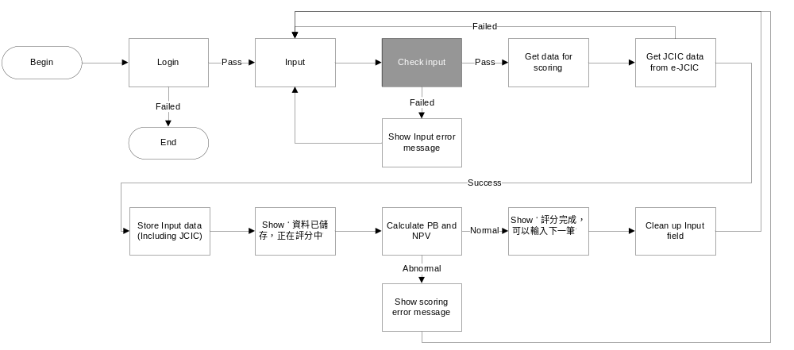
CHECK INPUT

Slide 40

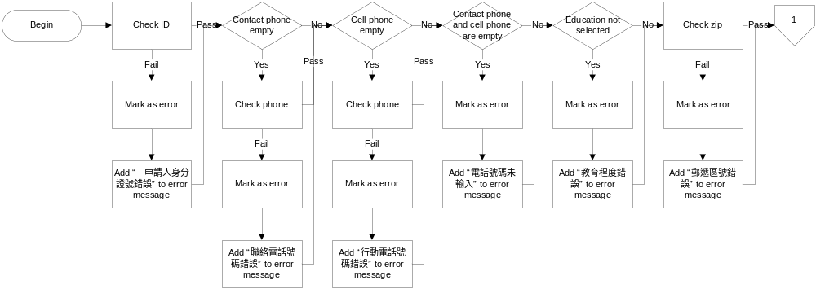
CHECK INPUT

Slide 41
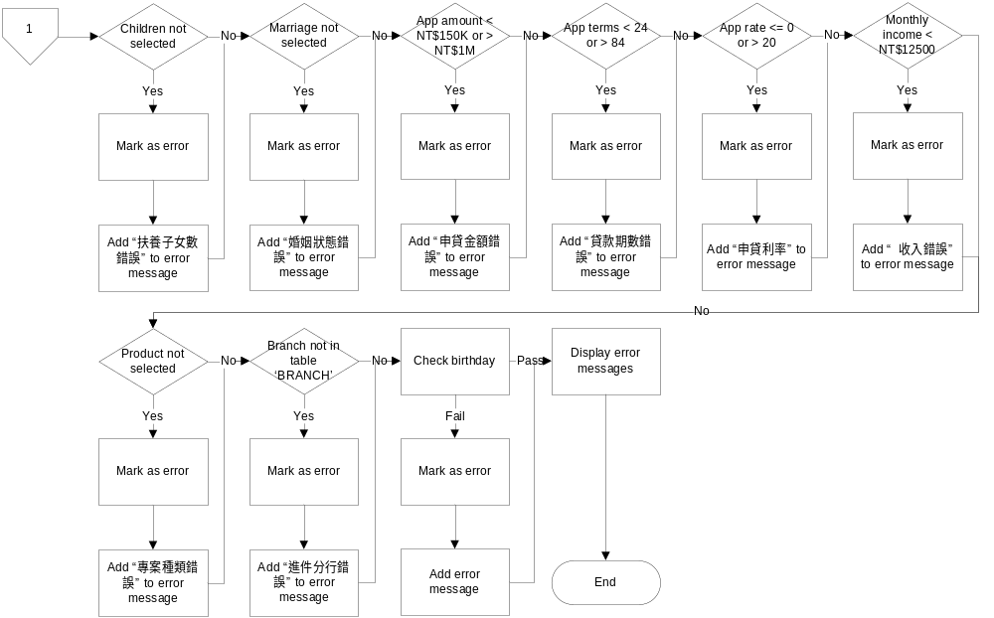
CHECK INPUT(CONT.)

Slide 42
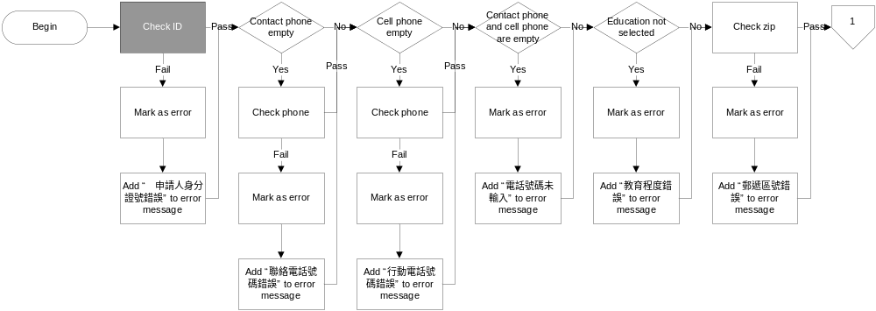
CHECK ID

Slide 43
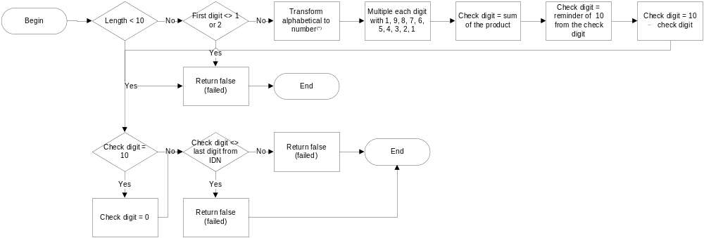
CHECK ID
(*)A = 10, B = 11, C = 12, D = 13, E = 14, F = 15, G = 16, H = 17, I = 34, J = 18, K = 19, L = 20, M = 21,
N = 22, O = 35, P = 23, Q = 24, R = 25, S = 26, T = 27, U = 28, V = 29, W = 32, X = 30, Y = 31, Z = 33

Slide 44
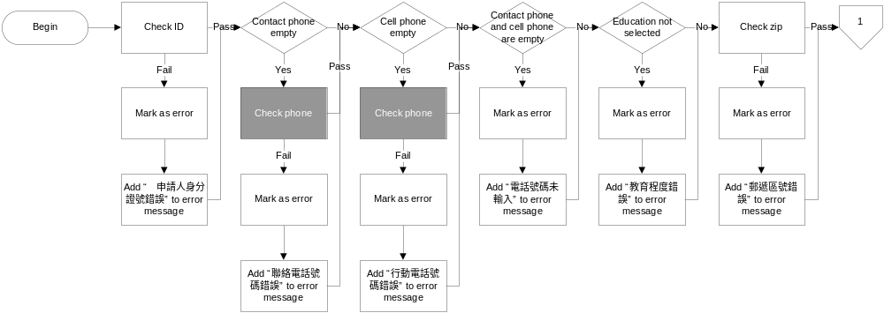
CHECK PHONE

Slide 45
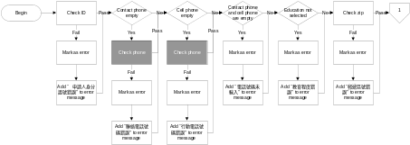
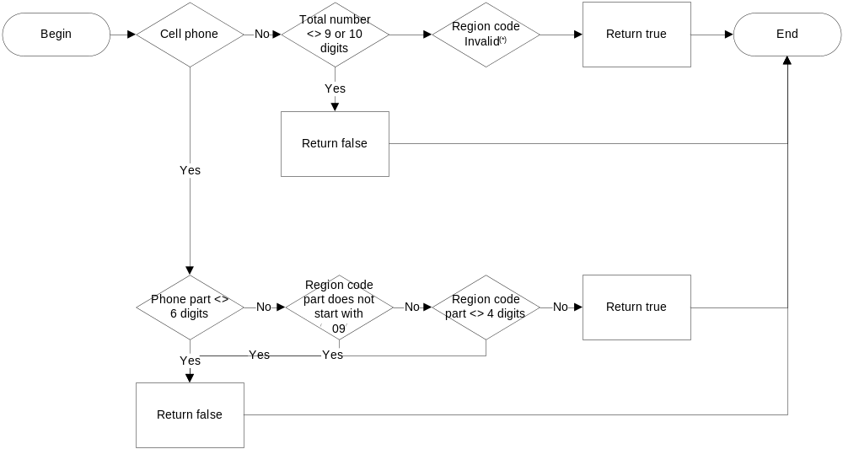
CHECK PHONE
(*) Valid region codes, according to 中華電信, are: 02, 03, 04, 05, 06, 07, 08, 037, 049, 082, 089, 826, 836

Slide 46
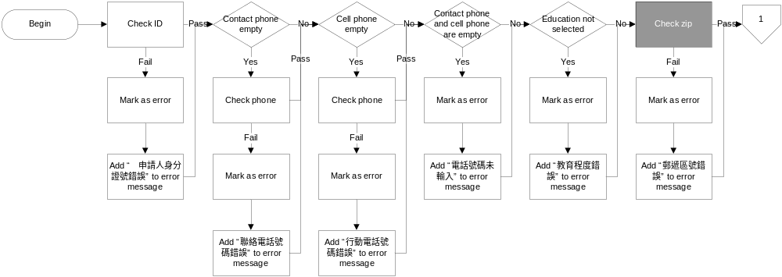
CHECK ZIP

Slide 47
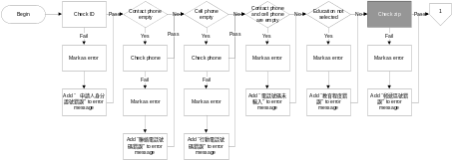
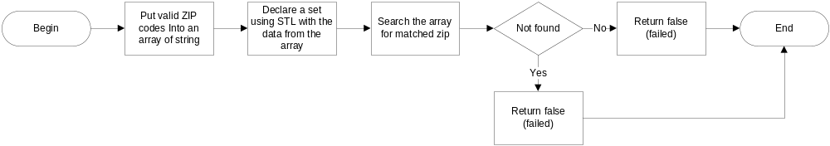
CHECK ZIP

Slide 48
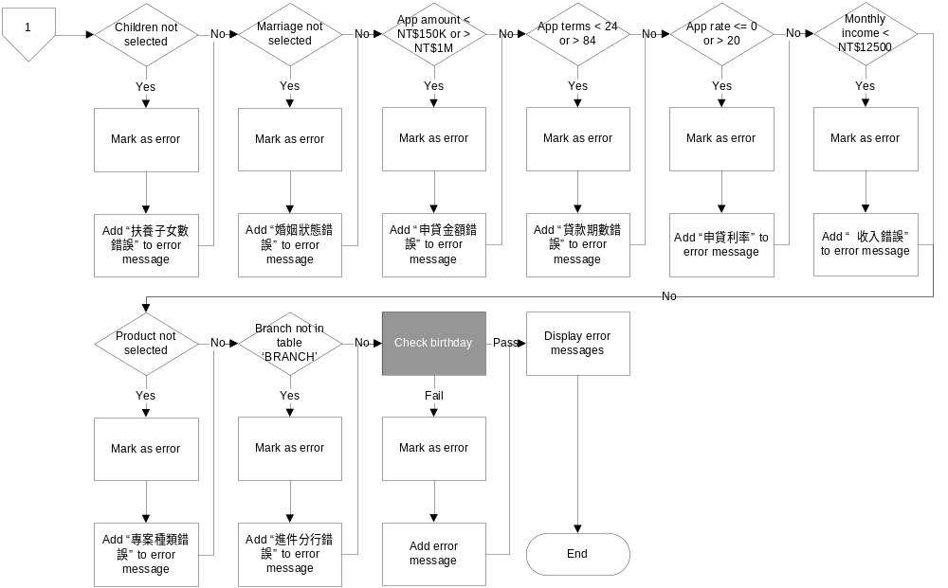
CHECK BIRTHDAT

Slide 49
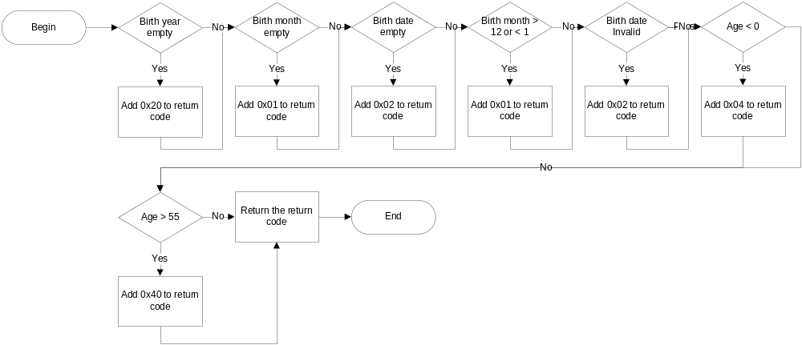
CHECK BIRTHDAT

Slide 50
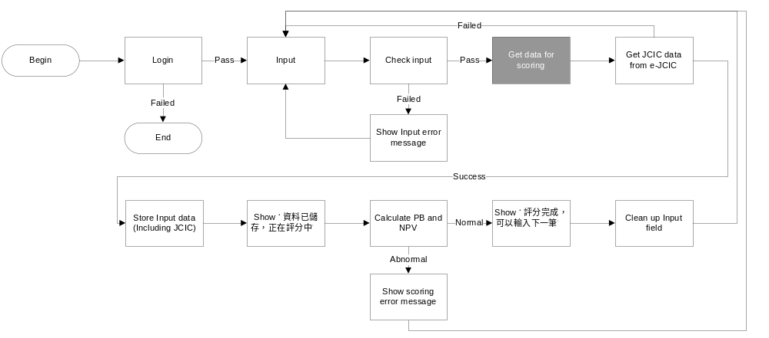
GET DATA FOR SCORING

Slide 51

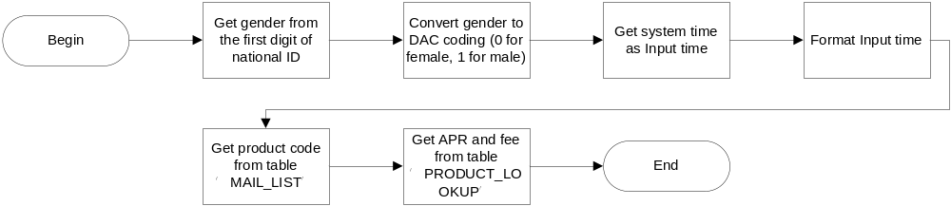
GET DATA FOR SCORING

Slide 52
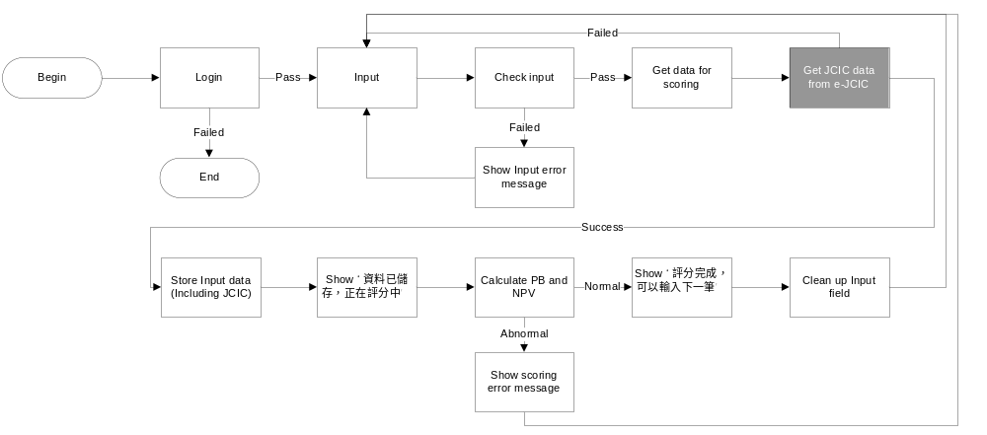
GET JCIC DATA FROM e-JCIC

Slide 53

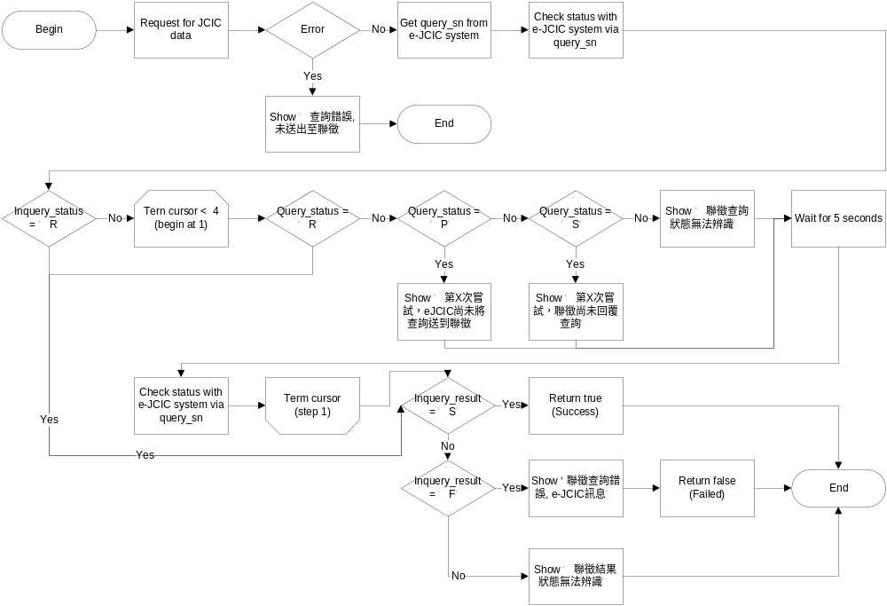
GET JCIC DATA FROM e-JCIC

Slide 54
GET JCIC DATA FROM e-JCIC
JCIC data includes
BAM086
JAS002
KRM021
KRM023
KRM037
STM007
VAM102

Slide 55
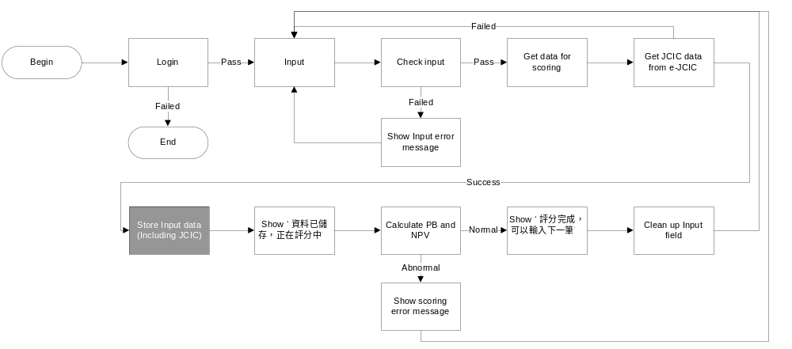
STORE INPUT DATA

Slide 56
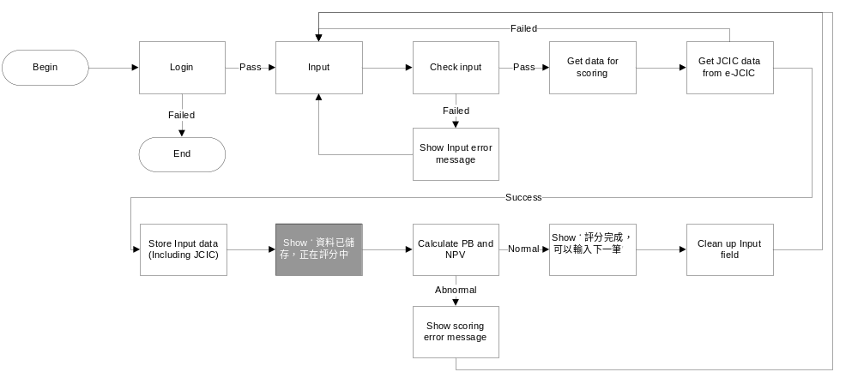
SHOW EXECUTION PROGRESS TO THE USER

Slide 57
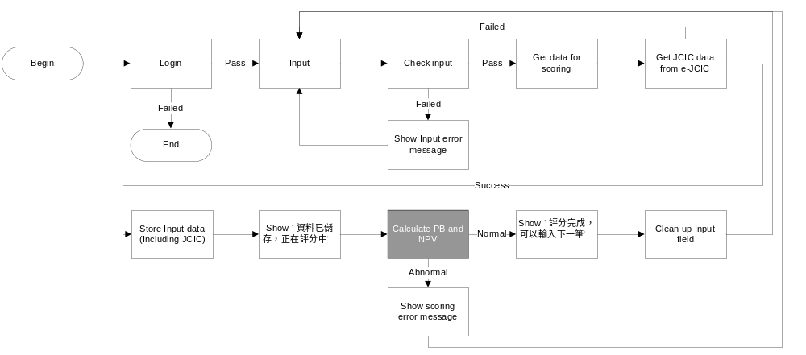
CALCULATE RISK AND NPV

Slide 58
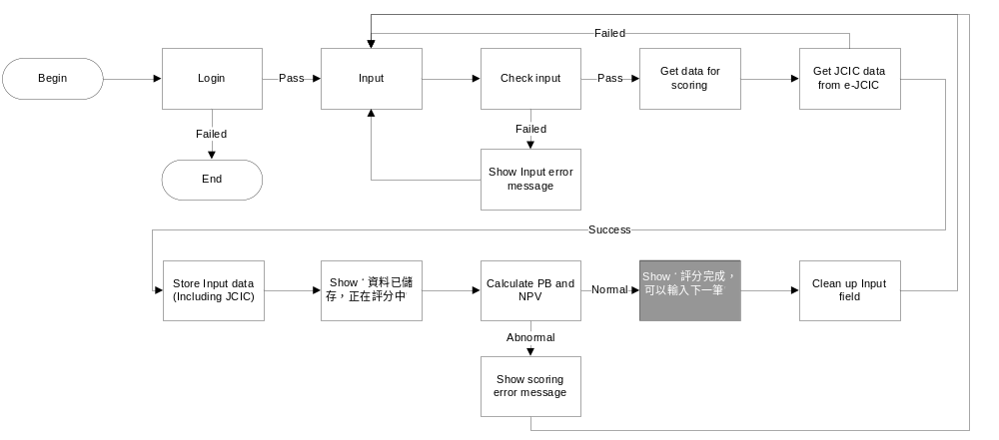
SHOW EXECUTION PROGRESS TO THE USER

Slide 59
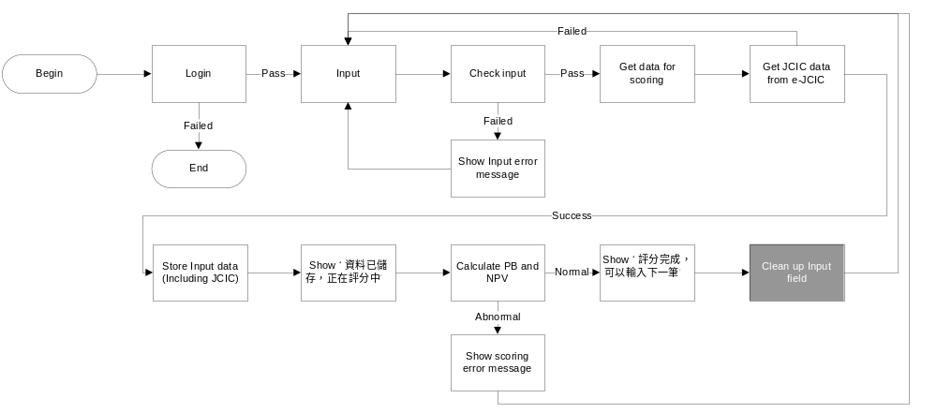
CLEAN INPUT FIELDS TO BE READY FOR NEXT INPUT

Slide 60
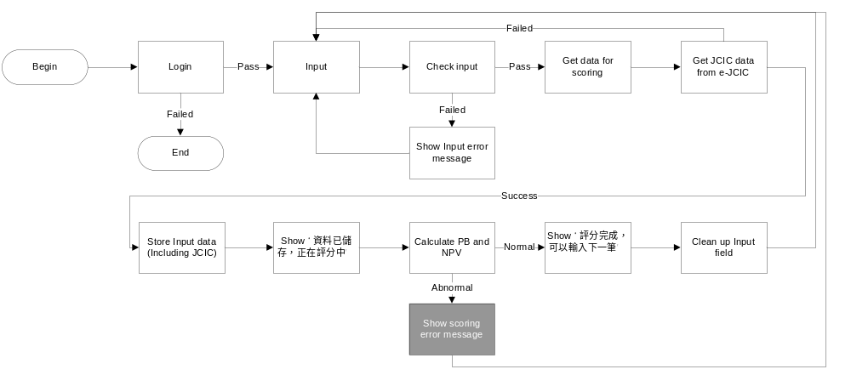
SHOW SCORING ERROR MESSAGES

Slide 61
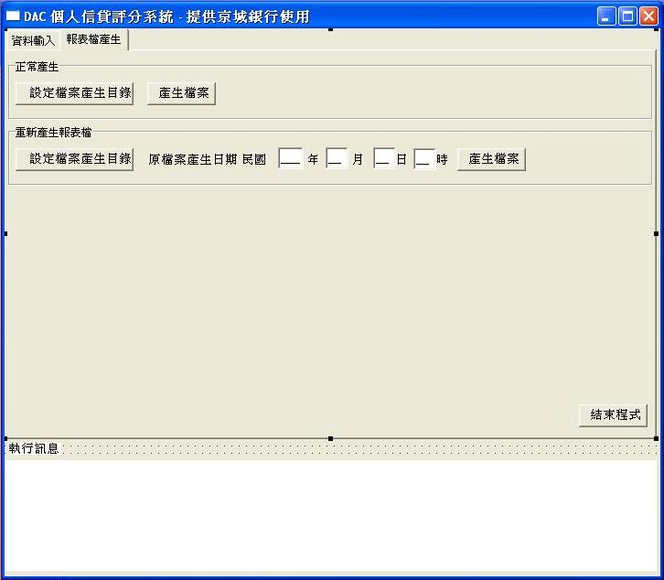
SHOW SCORING ERROR MESSAGES

Slide 62
GENERATE REPORTS

Slide 63
PURPOSES OF REPORTS
Report | Purpose
Total | Details every application during the reporting period, for the purpose of filing
Individual | Data source for report in one-page-one-application format for credit officers’ review
Manual review | Data source for report in one-page-one-application format for conducting manual review of the application

Slide 64
TOTAL REPORT DATA ITEMS
Report Part | Data item | Description
Header | 京城銀行個人信貸評分結果名單 | 報表名稱
Header | 名單產生時間 | 報表檔案產生時系統時間(YYYMMDDHHmm)
Header | 申請件輸入日期時間範圍 | 報表檔案中，最早與最晚的申請件輸入時間(YYYMMDDHHmm)
Header | 名單所含件數 | 報表檔案中申請件數
Content | 進件消金中心 | 進件消金中心
Content | 申請人身分證號 | 申請人身分證號
Content | 申請人姓名 | 申請人姓名
Content | 產品別 | 申請件產品代碼
Content | 申請件輸入時間 | 申請件輸入時間
Content | 申貸金額(NT$) | 申請人所填申貸金額
Content | 核准金額(NT$) | 核准模組核准金額
Content | 收入22倍限制下核准金額(NT$) | 根據申請人所填收入計算的金管會規定最高核准金額
Content | 無擔保貸款餘額(NT$) | 根據聯徵KRM023/37, BAM086計算

Slide 65
TOTAL REPORT DATA ITEMS(CONT.)
Report Part | Data item | Description
Content | 申貸期數 | 申請人所填申貸期數
Content | 申貸利率 | 申貸利率
Content | 模組建議 | 核准模組建議訊息
Content | 壞帳機率 | 核准模組輸出 PB
Content | 經濟價值 | 核准模組輸出 EV
Content | 最低可貸利率 | 模組輸出最低可貸利率
Content | 聯徵補充註記 | VAM102，債務協商註記
Trailer | /EOF | 代表以下無資料

Slide 66
INDIVIDUAL REPORT DATA ITEMS
Report Part | Data item | Description
Content | CFC | 消金中心
Content | Input_staff | 輸入員工編號
Content | Input_time | 申請件輸入時間
Content | Report_time | 報表檔案產生時系統時間(YYYMMDDHHmm)
Content | id | 申請人身分證號
Content | name | 申請人姓名
Content | fixed_phone | 申請人聯絡電話
Content | cell_phone | 申請人行動電話
Content | marriage_status | 申請人婚姻狀態
Content | children | 子女數
Content | education | 教育程度

Slide 67
INDIVIDUAL REPORT DATA ITEMS(CONT.)
Report Part | Data item | Description
Content | amount | 申請人所填申貸金額
Content | approved_amount | 核准模組核准金額
Content | approved_amunt_fsc | 根據申請人所填收入計算的金管會規定最高核准金額
Content | unsecured_balance | 根據聯徵KRM023/37, BAM086計算
Content | terms | 申請人所填申貸期數
Content | rate | 申貸利率
Content | suggestion | 核准模組建議訊息
Content | pb | 核准模組輸出 PB
Content | npv | 核准模組輸出 EV
Content | min_rate | 核准模組輸出最低可貸利率
Content | special_note | VAM102，債務協商註記

Slide 68
MANUAL REVIEW REPORT DATA ITEMS
Report Part | Data item | Description
Content | Report_time | 報表檔案產生時系統時間(YYYMMDDHHmm)
Content | name | 申請人姓名
Content | id | 申請人身分證號
Content | Input_time | 申請件輸入時間
Content | gender | 申請人性別
Content | fixed_phone | 申請人聯絡電話
Content | cell_phone | 申請人行動電話
Content | special_note | VAM102，債務協商註記

Slide 69
SET REPORT DIRECTORY

Slide 70
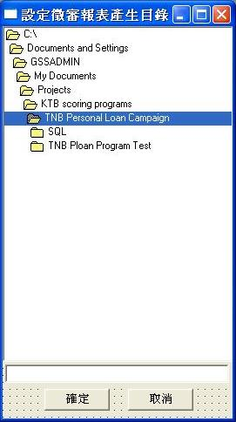
SET REPORT DIRECTORY

Slide 71
GENERATE REPORTS

Slide 72
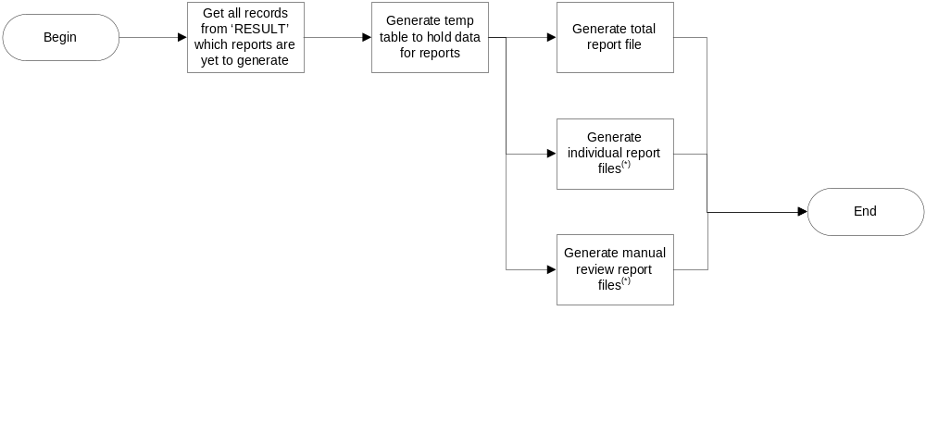
GENERATE OPERATIONAL REPORT FILES
(*) Two identical files, one with constant file name for print merge in Microsoft Word, the other for filing.

Slide 73
REGENERATE REPORTS

Slide 74
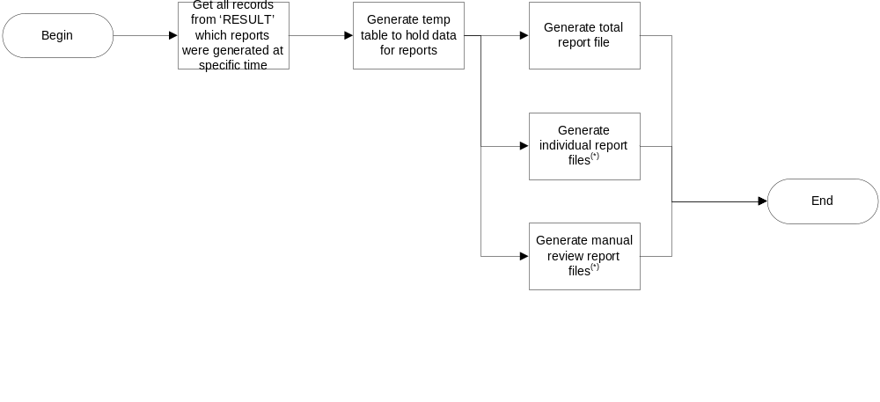
REGENERATE OPERATIONAL REPORT FILES
(*) Two identical files, one with constant file name for print merge in Microsoft Word, the other for filing.

Slide 75
CONTENTS
Technical highlights
Input and output environment
Program flow
Program files

Slide 76
PROGRAM FILES
File name | Description
MainUI.cpp | Input user interface Report generation user interface Get JCIC data Activate approval module Generate operational report
MainUI.h | Functions declaration for MainUI.cpp
LoginUI.cpp | Login user interface
LoginUI.h | Functions declaration for LoginUI.cpp

Slide 77
PROGRAM FILES(CONT.)
File name | Description
DirUI.cpp | Report directory setting user interface
DirUI.h | Functions declaration for DirUI.cpp
ReDirUI.cpp | Regenerated report directory setting user inferface
ReDirUI.h | Functions declaration for ReDirUI.cpp

